Slide 1
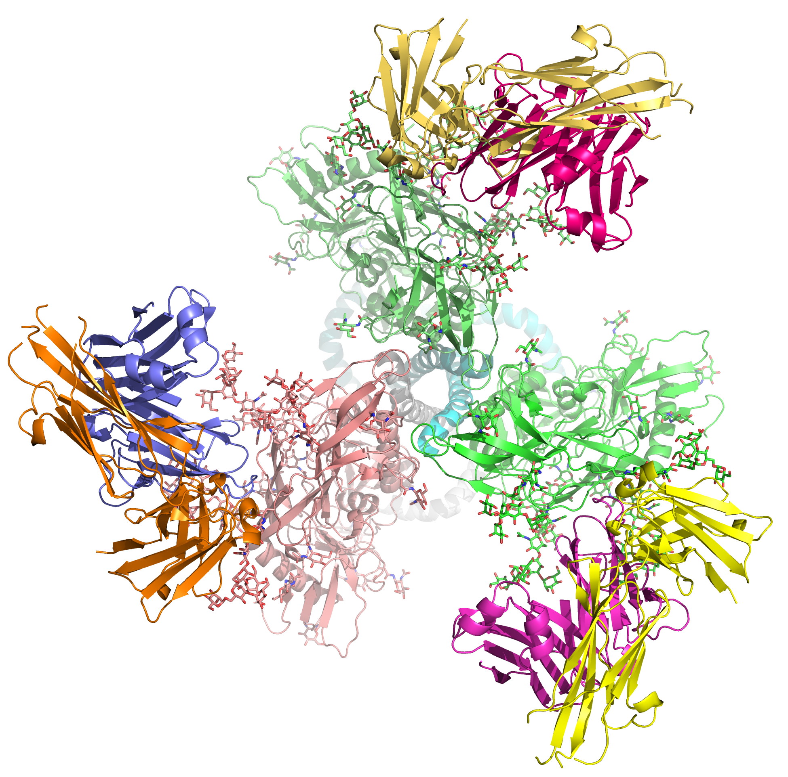
Induction of bNAbs by vaccines: where do we stand, what is being needed for success
Rogier Sanders
Academic Medical Center, University of Amsterdam, Netherlands
Weill Medical College of Cornell University, New York, U.S.A.
Symposia session “Broadly neutralizing antibodies (bNAbs): towards a cure and vaccine”, 22nd International AIDS Conference, Amsterdam, The Netherlands, July 26th, 2018

Slide 2
Disclosure of potential competing interests
My research group receives funding from Janssen Vaccines
I am listed on patents and patent applications related to stable HIV-1 envelope trimer vaccines

Slide 3

I want to begin with acknowledging and thanking the people living with HIV who have generously participated in this research

Slide 4
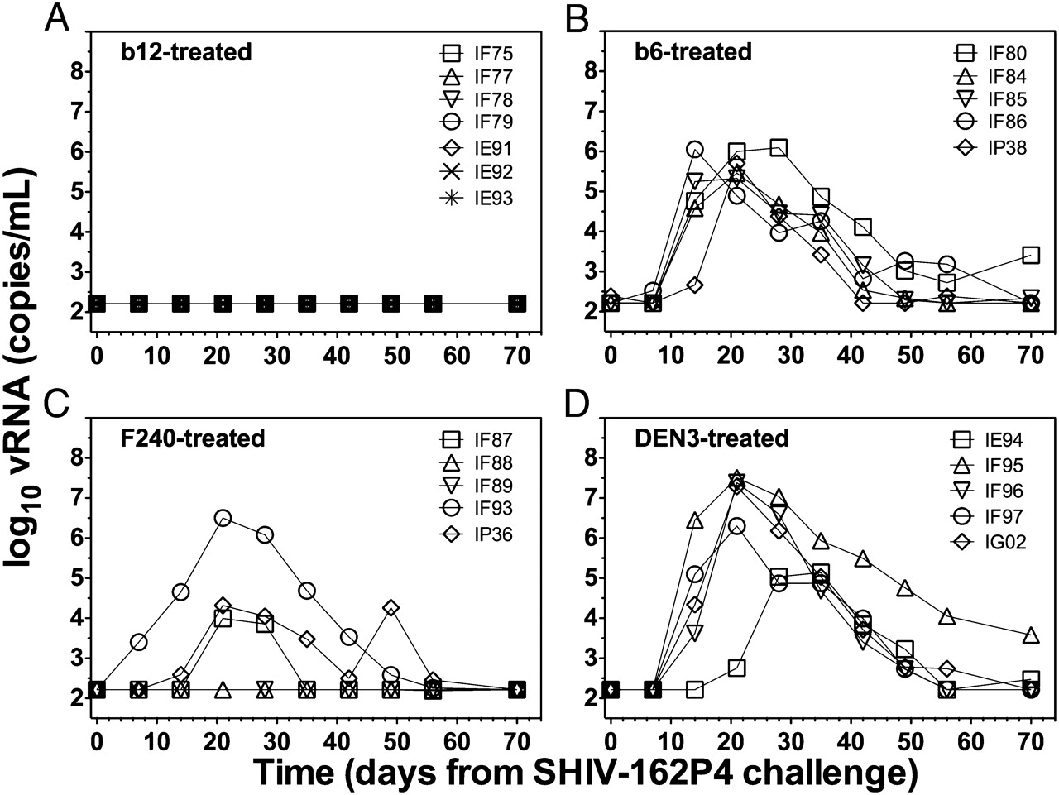
Neutralizing antibodies protect from HIV acquisition
Vaginal challenge experiments with SHIV in macaques
Neutralizing
Non-neutralizing
Burton et al. 2011. PNAS 108:11181-6.
Van Gils & Sanders. 2014. Trends Microbiol. 22:550-551
-> A goal for HIV: induce neutralizing antibodies (NAbs)

Slide 5
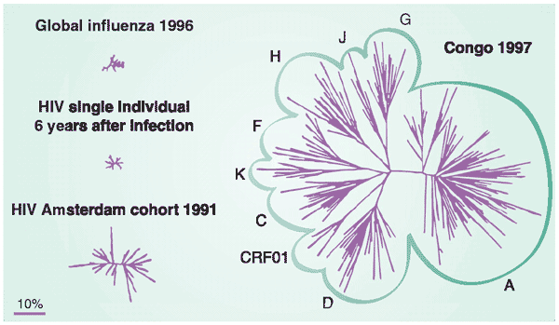
HIV is extremely variable
Weiss RA. 2003. Nat. Med. 9: 887 – 891.
-> Goal for HIV: induce broadly neutralizing antibodies (bNAbs)

Slide 6
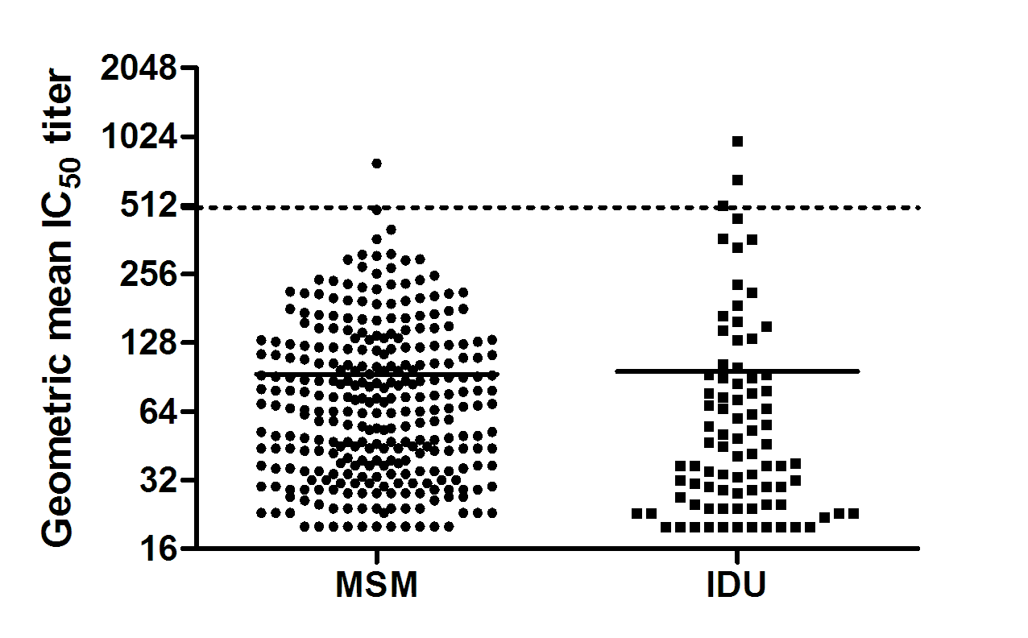
The human immune system can make bNAbs
bNAb responses in the Amsterdam Cohort
elite neutralization (~1%)
broad neutralization (~20%)
Euler et al., ms in preparation

Slide 7
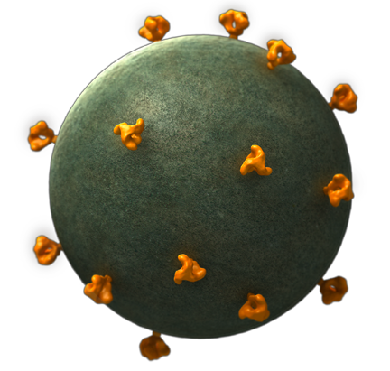
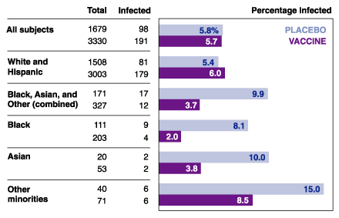
How to induce bNAbs by vaccination?
gp120
gp120
gp41
Native envelope spike
VaxGen’s AIDSVAX
Results VAXGEN recombinant gp120 vaccine efficacy trial

Slide 8
How to induce bNAbs by vaccination?
gp120
gp120
gp41
Native envelope spike
VaxGen’s AIDSVAX
Why does gp120 not induce bNAbs?
1. gp120 does not recapitulate the native, trimeric envelope spike
2. In natural infection, bNAbs do not emerge instantly and in response to a single antigen, but they are the product of co-evolution
3. gp120 generally does not activate desirable naïve B cells that have the intrinsic capacity to produce bNAbs

Slide 9
Novel Env immunogens based on 3 hypotheses
Observation 1: non-native Env forms (gp120, uncleaved gp140) do not induce strong neutralizing antibodies against primary (Tier-2) viruses
Hypothesis 1: stable native-like Env trimer immunogens should induce Tier-2 neutralizing antibodies
Lead immunogens: BG505 SOSIP.664 and ConM SOSIP.v7
Observation 2: In HIV-1 infected individuals broadly neutralizing antibodies do not emerge instantly in response to one antigen, but they are a product of co-evolution between the escaping virus and the chasing immune system
Hypothesis 2: Immunization with lineage Env immunogens (sequential Env series) from individuals developing broadly neutralizing antibodies might induce similar antibodies
Lead immunogens: CH505 gp120 series
Observation 3: current Env vaccines generally do not engage the germline precursors of known broadly neutralizing antibodies
Hypothesis 3: engineered germline-targeting Env immunogens that do engage these germline precursors might prime broadly neutralizing antibody lineages
Lead immunogens: eOD-GT8 60mer and BG505 SOSIP.v4.1-GT1.1

Slide 10
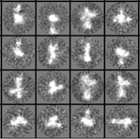
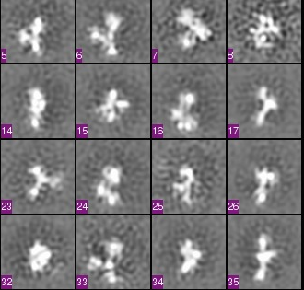
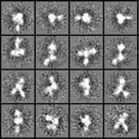
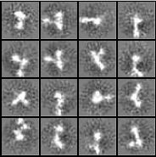
Previous Env vaccines do not induce autologous NAbs
Why not?
Because they do not recapitulate the native Env spike
Note 1: only data included for immunogens for which the autologous virus was tier 2
Note 2: only rabbit or guinea pig data
Note 3: Only TZM-bl neutralization data
Note 4: Apples and oranges comparison: different isolates, species, neut assays, labs
References:
Nkolola et al. 2010. J. Virol. 84:3270
92UG037.8 gp140-Fd
CZA97.012 gp140-Fd
Blish et al. 2010. J. Virol. 84:2573
Q461e2 gp140
Q168a2 gp140
This study
YU2 gp140-Fd
BG505 gp140 (=WT.SEKS)

Slide 11
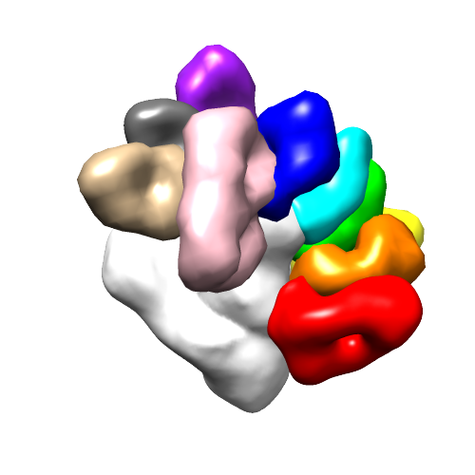
Hypothesis:
A stable structural and antigenic mimic of the native, cleaved envelope trimer should induce neutralizing antibodies
PG9
PGT135
SOSIP gp140
PGT122
CH103
PGT128
1NC9
gp120
2G12
PGT151
8ANC195
gp41
Sanders et al. 2002. J.Virol. 76: 8875
35O22
Native envelope spike
Derking et al. 2015. PLoS Path. 11: e1004767
3rd generation native-like envelope trimer: BG505 SOSIP gp140
R6
I559P
C1
V1
V2
C2
V3
C3
V4
C4
V5
C5
HR1
HR2
Sanders et al. 2013. PLoS Path. 9:e1003618
Julien et al. 2013 PNAS. 110:4351-4356
T332N
A501C
S-S
T605C

Slide 12
BG505 SOSIP induces autologous Tier 2 NAbs
Note 1: only data included for immunogens for which the autologous virus was tier 2
Note 2: only rabbit or guinea pig data
Note 3: Only TZM-bl neutralization data
Note 4: Apples and oranges comparison: different isolates, species, neut assays, labs
References:
Nkolola et al. 2010. J. Virol. 84:3270
92UG037.8 gp140-Fd
CZA97.012 gp140-Fd
Blish et al. 2010. J. Virol. 84:2573
Q461e2 gp140
Q168a2 gp140
This study
YU2 gp140-Fd
BG505 gp140 (=WT.SEKS)
BG505 SOSIP.664 gp140
Sanders et al. 2015. Science 349: aac4223

Slide 13
BG505 SOSIP induces autologous Tier 2 NAbs
P < 0.0001
Note 1: only data included for immunogens for which the autologous virus was tier 2
Note 2: only rabbit or guinea pig data
Note 3: Only TZM-bl neutralization data
Note 4: Apples and oranges comparison: different isolates, species, neut assays, labs
References:
Nkolola et al. 2010. J. Virol. 84:3270
92UG037.8 gp140-Fd
CZA97.012 gp140-Fd
Blish et al. 2010. J. Virol. 84:2573
Q461e2 gp140
Q168a2 gp140
This study
YU2 gp140-Fd
BG505 gp140 (=WT.SEKS)
BG505 SOSIP.664 gp140
Sanders et al. 2015. Science 349: aac4223

Slide 14
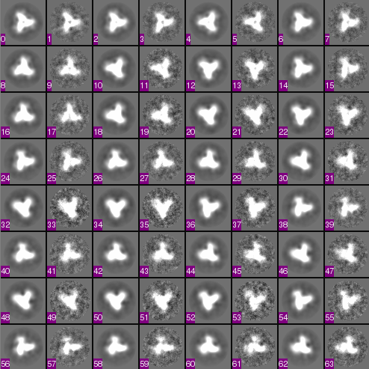
BG505 SOSIP induces autologous Tier 2 NAbs
P < 0.0001
Note 1: only data included for immunogens for which the autologous virus was tier 2
Note 2: only rabbit or guinea pig data
Note 3: Only TZM-bl neutralization data
Note 4: Apples and oranges comparison: different isolates, species, neut assays, labs
References:
Nkolola et al. 2010. J. Virol. 84:3270
92UG037.8 gp140-Fd
CZA97.012 gp140-Fd
Blish et al. 2010. J. Virol. 84:2573
Q461e2 gp140
Q168a2 gp140
This study
YU2 gp140-Fd
BG505 gp140 (=WT.SEKS)
BG505 SOSIP.664 gp140

Slide 15
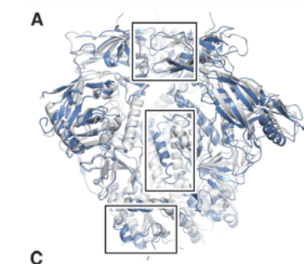
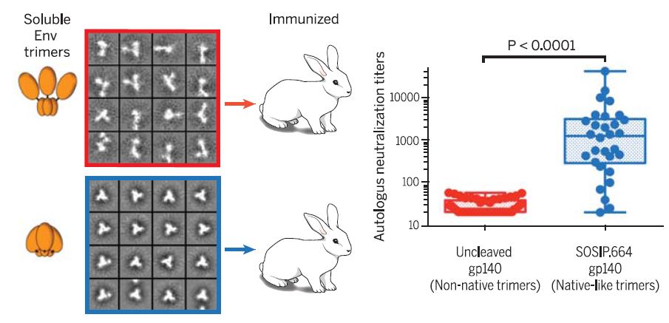
Native-like Env immunogens: BG505 SOSIP.664
Preclinical observations in vitro
- BG505 SOSIP.664 mimics the native trimer structure
- BG505 SOSIP.664 binds to most known broadly neutralizing antibodies including ones that require native-like quaternary trimer structure
Sanders et al. 2013. PLoS Path. 9:e1003618
Derking et al. 2015. PLoS Path. 11: e1004767
Lee et al. 2016. Science 351:1043-8
PG9
PGT135
Blue: JR-FL gp160
White: BG505 SOSIP
PGT122
CH103
PGT128
1NC9
2G12
PGT151
8ANC195
35O22
Preclinical observations in vivo
- BG505 SOSIP.664 induces neutralizing antibodies against the parental Tier-2 BG505 virus in rabbits and macaques
Sanders et al. 2015. Science 349: aac4223
De Taeye et al. 2015. Cell. 2015 163:1702-15
Pauthner et al. 2017. Immunity 46:1073-1088.e6

Slide 16



Native-like Env immunogens: BG505 SOSIP.664
Clinical trial 1 (W001): dose-ranging (AS01b; GSK)
Clinical trial 2: adjuvant screening (J. McElrath)
Goals:
Evaluate the safety and immunogenicity of BG505 SOSIP.664 in healthy adults
Evaluate whether the BG505 SOSIP.664 trimer can induce Tier-2 neutralizing antibody responses in humans
Immunogen: BG505 SOSIP.664
Vaccinations (months)
0
2
6
Lead scientists | Moore/Sanders
Funders | NIH (HIVRAD/HVTN) & BMGF (IAVI VxPDC)
Manufacturer | KBI Biopharma
GMP finished | Q2 2017
Clinical trial start | Q3 2018
Clinical sites | Ragon Institute & FHCRC, Kenia

Slide 17
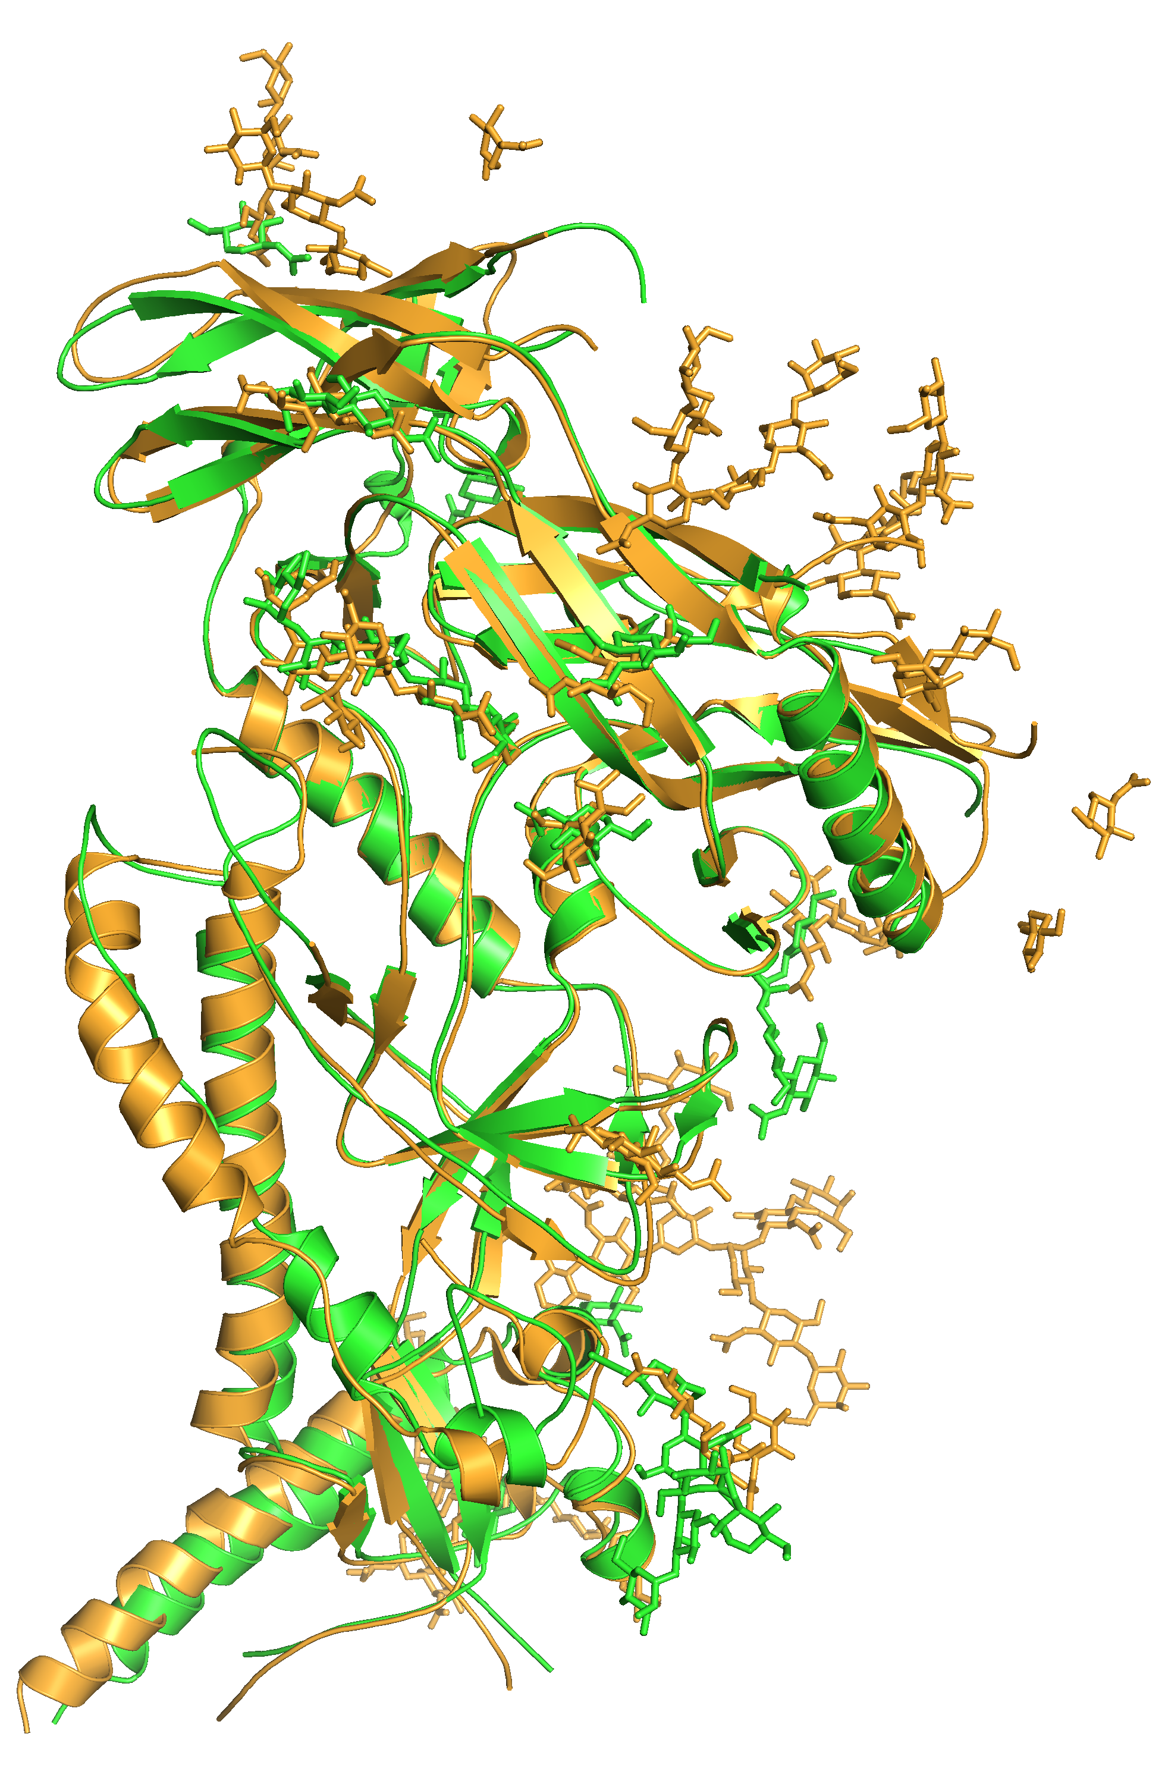
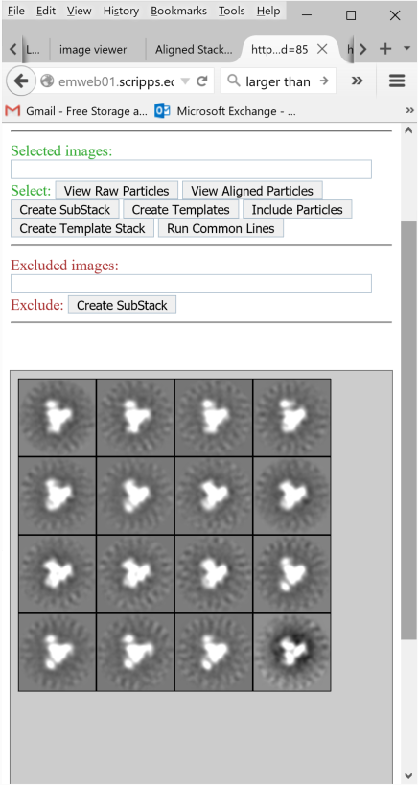

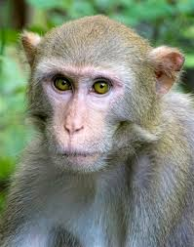
Native-like Env immunogens: ConM SOSIP.v7
Preclinical observations in vitro
- ConM SOSIP.v7 mimics the native trimer structure
- ConM SOSIP.v7 binds to most known broadly neutralizing antibodies including ones that require native-like quaternary trimer structure
Unpublished results
Byung Woo Han
Ian Wilson
ConM SOSIP & JR-FL gp160 (5FUU.pdb)
r.m.s.d. distance: 0.988 Å
ConM (Tier 1A)
ConS (Tier 2)
**
Preclinical observations in vivo
- ConM SOSIP.v7 induces neutralizing antibodies against the parental ConM and related Tier-2 ConS virus in rabbits and macaques
Unpublished results

Slide 18




Native-like Env immunogens: ConM SOSIP.v7
Clinical trial 1: ConM SOSIP.v7, ConS SLUFO , +/- cross-linking (ICL)
Clinical trial 2: ConM SOSIP.v7, fractional dose (AMC)
Goals:
Evaluate the safety and immunogenicity of ConM SOSIP.v7 in healthy adults
Evaluate whether the ConM SOSIP.v7 trimer can induce Tier-2 neutralizing antibody responses in humans
Immunogen: ConM SOSIP.v7
Vaccinations (months)
0
2 or 3
6
Lead scientists | Sanders/Shattock
Funder | EU (ERC & EAVI2020)
Manufacturer | Polymun
GMP finished | Q4 2017
Clinical trial start | Q1 2019
Clinical sites | ICL & AMC
#681137
ERC-StG-2011-280829

Slide 19
Novel Env immunogens based on 3 hypotheses
Observation 1: non-native Env forms (gp120, uncleaved gp140) do not induce neutralizing antibodies against primary (Tier-2) viruses
Hypothesis 1: native-like Env trimer immunogens should induce Tier-2 neutralizing antibodies
Lead immunogens: BG505 SOSIP.664 and ConM SOSIP.v7
Observation 2: In HIV-1 infected individuals broadly neutralizing antibodies do not emerge instantly in response to one antigen, but they are a product of co-evolution between the escaping virus and the chasing immune system
Hypothesis 2: Immunization with lineage Env immunogens (sequential Env series) from individuals developing broadly neutralizing antibodies might induce similar antibodies
Lead immunogens: CH505 gp120 series
Observation 3: current Env vaccines generally do not engage the germline precursors of known broadly neutralizing antibodies
Hypothesis 3: engineered germline-targeting Env immunogens that do engage these germline precursors might prime broadly neutralizing antibody lineages
Lead immunogens: eOD-GT8 60mer and BG505 SOSIP.v4.1-GT1.1

Slide 20
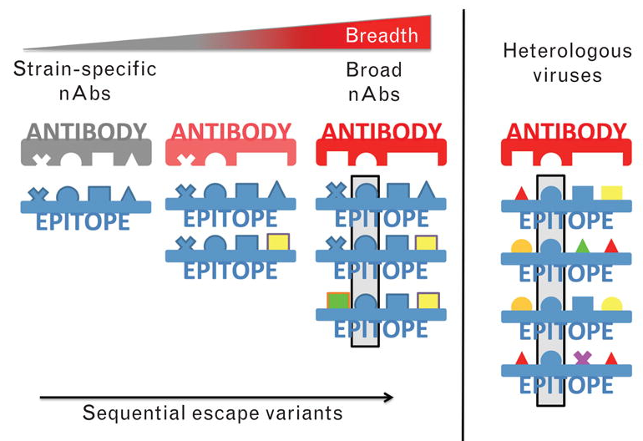
bNAbs evolve from strain-specific NAbs
by adapting to viral escape variants
Derdeyn CA et al. 2014. Curr.Opin.HIV AIDS 9:210

Slide 21

Lineage Env immunogens: CH505 gp120 series
CH505 Env and CH103 Ab co-evolution leading to broad neutralization
Env:
CH505
T/F
CH505
wk53
CH505
wk78
CH505
wk100
CH505
wk136
Env-Ab
complex
UCA
CH103 lineage intermediate antibodies
CH103
CH103 lineage antibodies
CH187
CH188
CH186
CH120
CH104
CH105
CH106
CH103
CH243
CH244
CH245
CH247
UCA
IA92U
CH248
IA8
IA7
IA6
IA4
IA3
IA2
IA1
TF
CH505
Envs
wk53
wk78
wk100
0.09
1.7
3.3
4.9
6.5
8.1
9.7
11.3
12.9
Binding titer (Log AUC)
Courtesy of Bart Haynes

Slide 22
Lineage Env immunogens: CH505 gp120 series
Clinical trial 1 (HVTN115A): dose-ranging with TF
Clinical trial 2 (HVTN115B): lineage immunization
TF
Wk 53
Wk 78
Wk 100
Wk 100
Wk 100
0
2
4
8
12
16
Vaccinations (months)
Goals:
Evaluate the safety and immunogenicity of CH505 lineage immunogens in healthy adults
Evaluate whether the CH505 lineage gp120 can induce CH103-like bNAb responses
Lead scientist | Haynes
Funder | NIH (CHAVI-ID & DAIDS)
Manufacturer | KBI Biopharma
GMP finished | Q2 2017
Clinical trial start | Q4 2017, Q3 2018
Clinical site | Duke Univ.
Courtesy of Bart Haynes

Slide 23
Novel Env immunogens based on 3 hypotheses
Observation 1: non-native Env forms (gp120, uncleaved gp140) do not induce neutralizing antibodies against primary (Tier-2) viruses
Hypothesis 1: native-like Env trimer immunogens should induce Tier-2 neutralizing antibodies
Lead immunogens: BG505 SOSIP.664 and ConM SOSIP.v7
Observation 2: In HIV-1 infected individuals broadly neutralizing antibodies do not emerge instantly in response to one antigen, but they are a product of co-evolution between the escaping virus and the chasing immune system
Hypothesis 2: Immunization with lineage Env immunogens (sequential Env series) from individuals developing broadly neutralizing antibodies might induce similar antibodies
Lead immunogens: CH505 gp120 series
Observation 3: current Env vaccines generally do not engage the germline precursors of known broadly neutralizing antibodies
Hypothesis 3: engineered germline-targeting Env immunogens that do engage these germline precursors might prime broadly neutralizing antibody lineages
Lead immunogens: eOD-GT8 60mer and BG505 SOSIP.v4.1-GT1.1

Slide 24

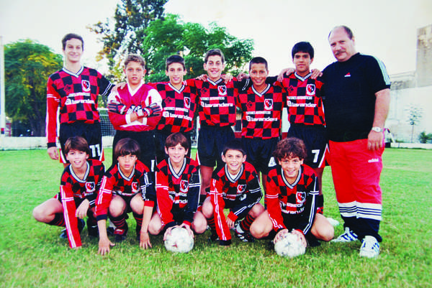
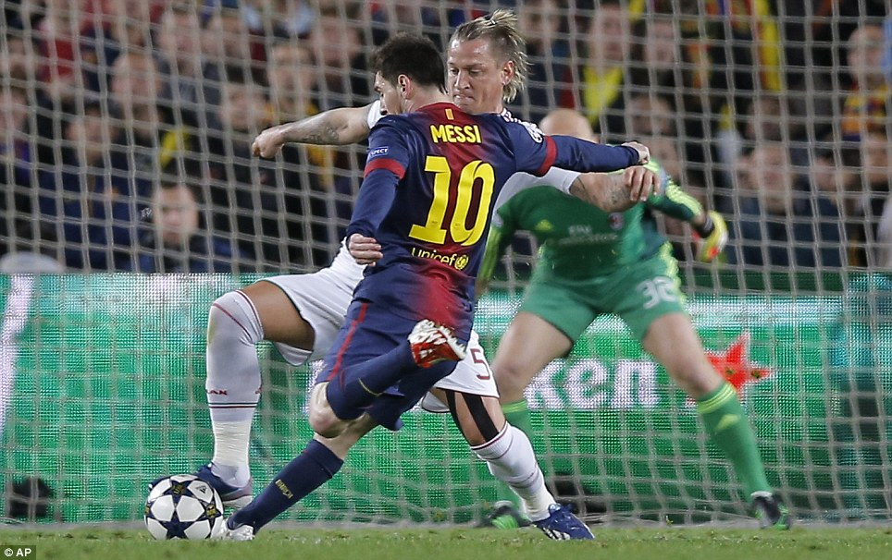
Germline-targeting immunogens: Hypothesis
Not all naive B cells are created equal!
Specifically select those germline antibody precursors that have
the capacity to mature into broadly neutralizing antibodies
non-neutralizing antibody
germline antibody precursors
Adapted from Medina-Ramírez
broadly neutralizing antibody

Slide 25
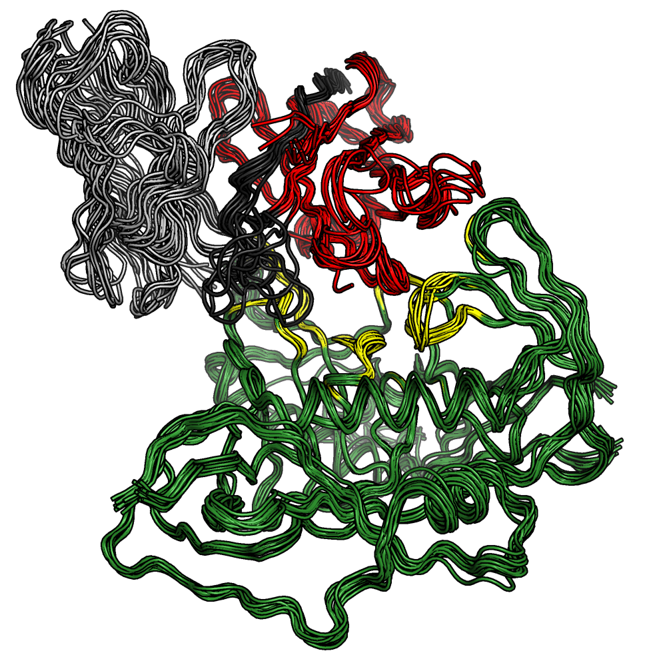
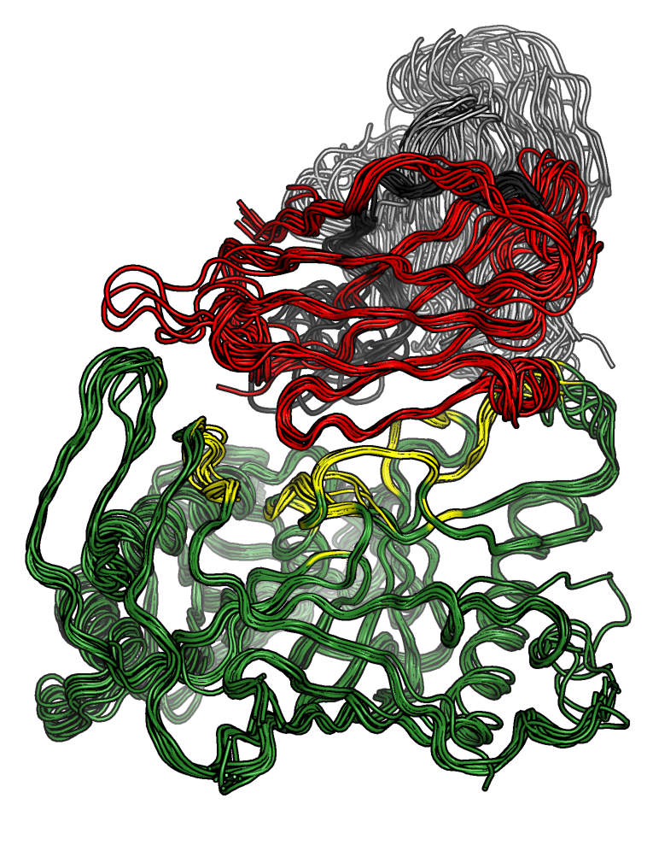
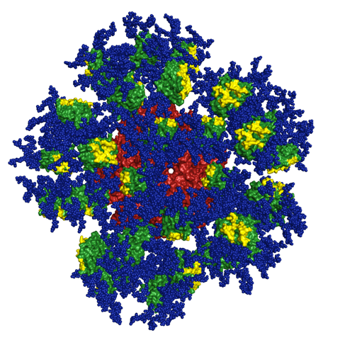
Germline-targeting immunogens: eOD-GT8 60-mer
Preclinical observations in vivo
eOD-GT8 60mer primes VRC01-class precursors in various KI mouse models
eOD-GT8 can isolate VRC01-class precursors from human naïve B cells, frequency of 1 in 2.4 million.
eOD-GT8 60mer primes VRC01-class precursors in Kymab Ig-locus transgenic mice that have only ~1 VRC01-class precursor per mouse.
VRC01-class precursors primed by eOD-GT8 60mer can be boosted to produce antibodies with properties of partially mature VRC01-class bnAbs
Jardine, Ota, Sok, Science 2015; Dosenovic et al. Cell 2015; Jardine et al. Science 2016; Sok et al. Science 2016; Briney et al. Cell 2016; Tian et al. Cell 2016
VRC01-class Abs use:
VH1-2 and 5AA L-CDR3
Germline-Targeting
eOD-GT8 60mer
Courtesy of Bill Schief

Slide 26
Germline-targeting immunogens: eOD-GT8 60-mer
Clinical trial outline
Goals:
Evaluate the safety and immunogenicity of two doses of eOD-GT8 60mer / AS01b in healthy HIV uninfected adults
Evaluate whether the eOD-GT8 60mer vaccine can activate VRC01-class precursor B cells and select early somatic mutations productive for bNAb development
Germline-targeting prime
eOD-GT8 60-mer
0
2
Vaccinations (months)
Lead scientist | Schief
Funder | BMGF (IAVI NAC & VxPDC)
Manufacturer | Paragon Bioservices
GMP finished | Q4 2017
Clinical trial start | Q2 2018
Clinical site | G.W. Univ. & FHCRC
Courtesy of Bill Schief

Slide 27
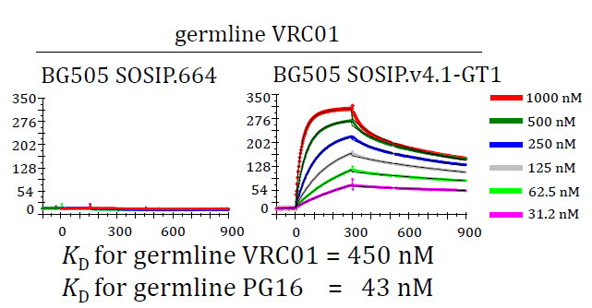
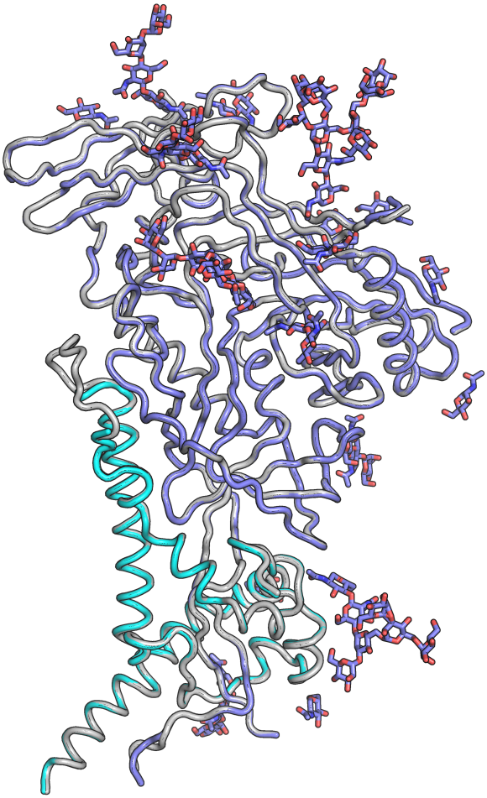
Germline-targeting immunogens: BG505 SOSIP.v4.1-GT1.1
Preclinical observations in vitro
- BG505 SOSIP.v4.1-GT1.1 (GT1.1) engages multiple bNAb germline precursors in vitro
- GT1.1 activates B cells expressing bNAb germline precursors as their BCR
Medina-Ramirez et al. 2017. J.Exp.Med, in press and unpublished results
BG505 SOSIP.v4.1-GT1
BG505 SOSIP.664
Preclinical observations in vivo
GT1.1 induces BG505 neutralizing antibodies in rabbits
GT1.1 activates multiple bNAb germline precursors (prerearranged and unrearranged) in multiple knock-in mouse models
Medina-Ramirez et al. 2017. J.Exp.Med, in press and unpublished results

Slide 28
Germline-targeting immunogens: BG505 SOSIP.v4.1-GT1.1
Possible clinical trial outline
Goals:
Evaluate the safety and immunogenicity of two doses of GT1.1 / AS01b in healthy HIV uninfected adults
Evaluate whether the GT1.1 trimer can activate CD4bs-class and V2-apex class precursor B cells
Evaluate whether such B cells can be further matured by boosting with heterologous trimers
Germline-targeting prime
BG505 SOSIP.v4.1-GT1.1
(vs. BG505 SOSIP.664 control)
0
2
12
Vaccinations (months)
Lead scientists | Sanders/Moore
Funders | NIH (HIVRAD) & BMGF (IAVI VxPDC)
Manufacturer | KBI Biopharma
GMP finished | Q2 2019 ?
Clinical trial start | Q3 2019 ?
Clinical sites | TBD

Slide 29
Germline-targeting immunogens: BG505 SOSIP.v4.1-GT1.1
Possible clinical trial outline
Germline-targeting prime
BG505 SOSIP.v4.1-GT1.1
(vs. BG505 SOSIP.664 ctrl)
Mature trimer boost
BG505 SOSIP.664 or
ConM SOSIP.v7 or other
0
2
6
12
Vaccinations (months)
Lead scientists | Sanders/Moore
Funders | NIH (HIVRAD) & BMGF (IAVI VxPDC)
Manufacturer | KBI Biopharma
GMP finished | Q2 2019 ?
Clinical trial start | Q3 2019 ?
Clinical sites | TBD

Slide 30
Summary/Conclusions
Native-like trimers are a promising platform for the induction of HIV-1 neutralizing antibodies.
Germline-targeting should prime the desirable naive B cells that have the capacity to generate broadly neutralizing antibodies.
Lineage immunogens, derived from patients that developed broadly neutralizing antibodies might guide the antibody response towards neutralization breadth.
None of these strategies are mutually exclusive.
In contrast, these strategies are likely to converge.
Germline priming – native-like trimer boosting
Lineage immunogens based on trimers
Germline priming followed by lineage immunogens
Etc.
These strategies provide promising avenues towards an HIV-1 vaccine that induces broadly neutralizing antibodies

Slide 31






Acknowledgements
Duke University
Celia Labranche
David Montefiori
Laurent Verkoczy
Jinsong Zhang
Hilary Bouton-Verville
Bart Haynes
FHCRC
Andy McGuire
Leo Stamatatos
U. Washington
Neil King
David Baker
BPRC
Petra Mooij
Gerrit Koopman
Willy Bogers
Polymun
Dietmar Katinger
Philipp Mundsperger
Academic Medical Center,
Max Medina-Ramirez
Marit van Gils
Philip Brouwer
Ronald Derking
Miguel Camacho
Alba Torrents de la Peña
Ivan Del Moral-Sanchez
Steven de Taeye
Marlies van Haaren
Kwinten Sliepen
Ilja Bontjer
Edith Schermer
Patricia van der Woude
Marielle van Breemen
Emma Reiss
Anna Schorcht
VRC
John Mascola
Alberto Cagigi
David Leggat
Adrian McDermott
Cornell University
Pavel Pugach
Rajesh Ringe
Tom Ketas
Al Cupo
Anila Yasmeen
PJ Klasse
John Moore
Rockefeller U.
Pia Dosenovic
Amelia Escolano
Michel Nussenzweig
Harvard U.
Ming Tian
Hwei-Ling Cheng
Frederick Alt
IAVI
Tom Hassell
Antu Dey
Scripps, La Jolla
Fernando Garces
Gabe Ozorowski
Jon Torres
Chris Cottrell
Kimmo Rantalainen
Zack Berndsen
Aleks Antanasijevic
Takayuti Ota
Patrick Skog
Dennis Burton
David Nemazee
Ian Wilson
Andrew Ward
Oxford University
Anna-Janina Behrens
Laura Pritchard
Quentin Sattentau
Max Crispin
Imperial College
Robin Shattock
#2016042
Vidi 917.11.314
Pervin Anklesaria
#681137
ERC-StG-2011-280829

Slide 32
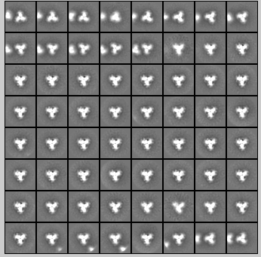
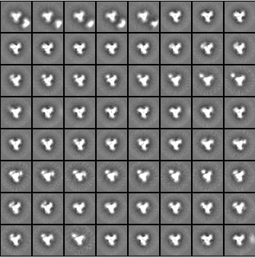
Elite neutralizers from the Amsterdam Cohort
for lineage vaccines
AMC011 SOSIP.v4.2
AMC009 and AMC011
Early sequences from elite neutralizers
elite neutralization (~1%)
AMC009
AMC011
T_{m} = 63.0°C (DSC)
broad neutralization (~20%)
AMC009 SOSIP.v4.2
Euler et al., ms in preparation
Tom van den Kerkhof, Anna Schorcht
T_{m} = 67.7°C (DSC)

Slide 33
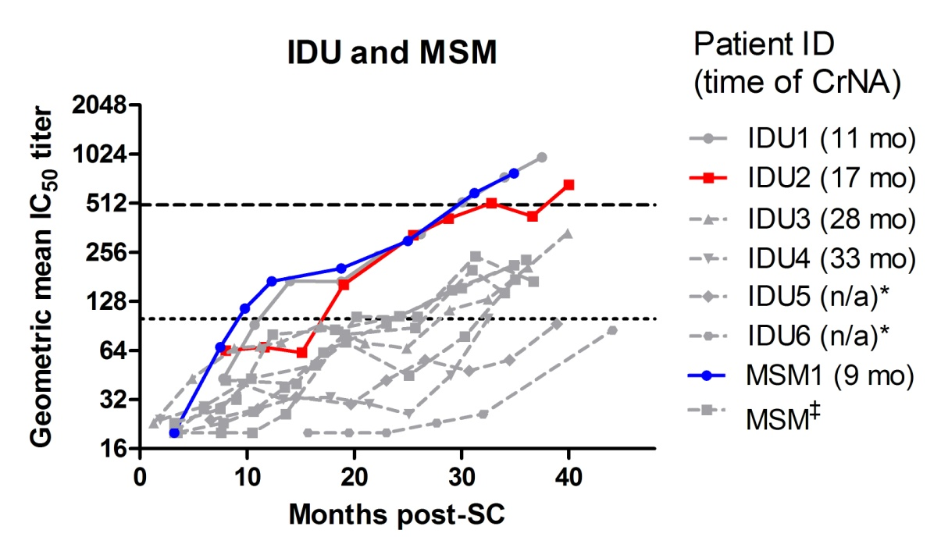
Elite neutralizers from the Amsterdam Cohort
for lineage vaccines
AMC011 SOSIP.v4.2
T_{m} = 63.0°C (DSC)
AMC009 SOSIP.v4.2
AMC011 SOSIP from 8 months post-seroconversion
AMC009 SOSIP from 2 months post-seroconversion
Van den Kerkhof et al. 2014, AIDS 28:1237–1240
Tom van den Kerkhof, Anna Schorcht
T_{m} = 67.7°C (DSC)

Slide 34
A versatile two-component nanoparticle platform for
the particulate presentation of SOSIP trimers
A
+
B
A-SOSIP
+
B
Neil King, David Baker
Philip Brouwer, Chris Cottrell, Zack Berndsen, Andrew Ward

Slide 35
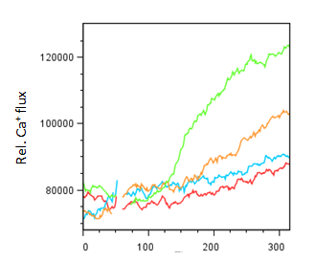
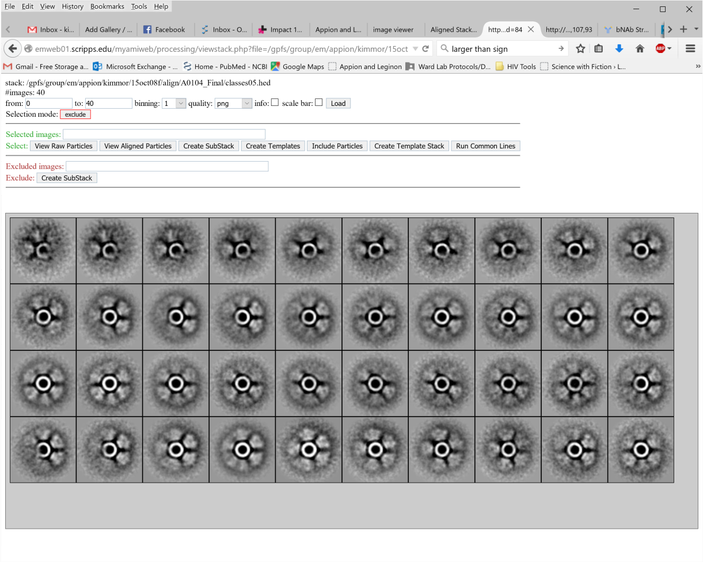

Nanoparticle presentation of SOSIP trimers enhances activation of B cells with an Ag-specific BCR
PGT145-expressing WEHI-231 B cells (Ota & Nemazee) were mixed with either free ConM SOSIP.v7 trimers, or nanoparticle-associated SOSIP trimers (equimolar amount of SOSIP trimer; 5 μg/ml)
Ca+ flux was measured using intracellular calcium staining (INDO-1)
Similar results were obtained with PG16/VRC01/PGT121-expressing B cells
Construct | # Trimers/ Particle
Mock | 0
SOSIP.v7 | 1
SOSIP.v7-ferritin | 8
SOSIP.v7-NPs | 20
1 trimer
8 trimers
20 trimers
Philip Brouwer, Miguel Camacho

Slide 36
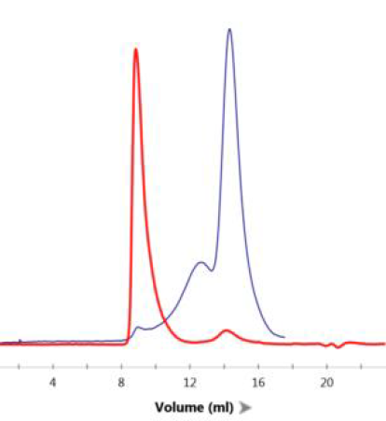
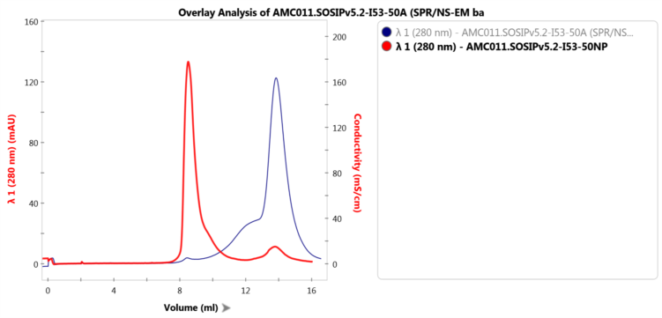
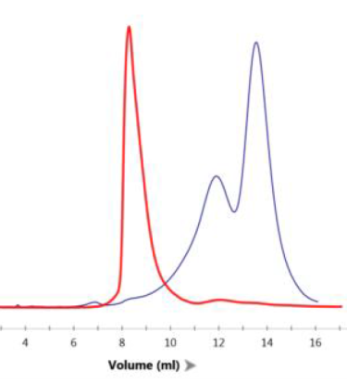
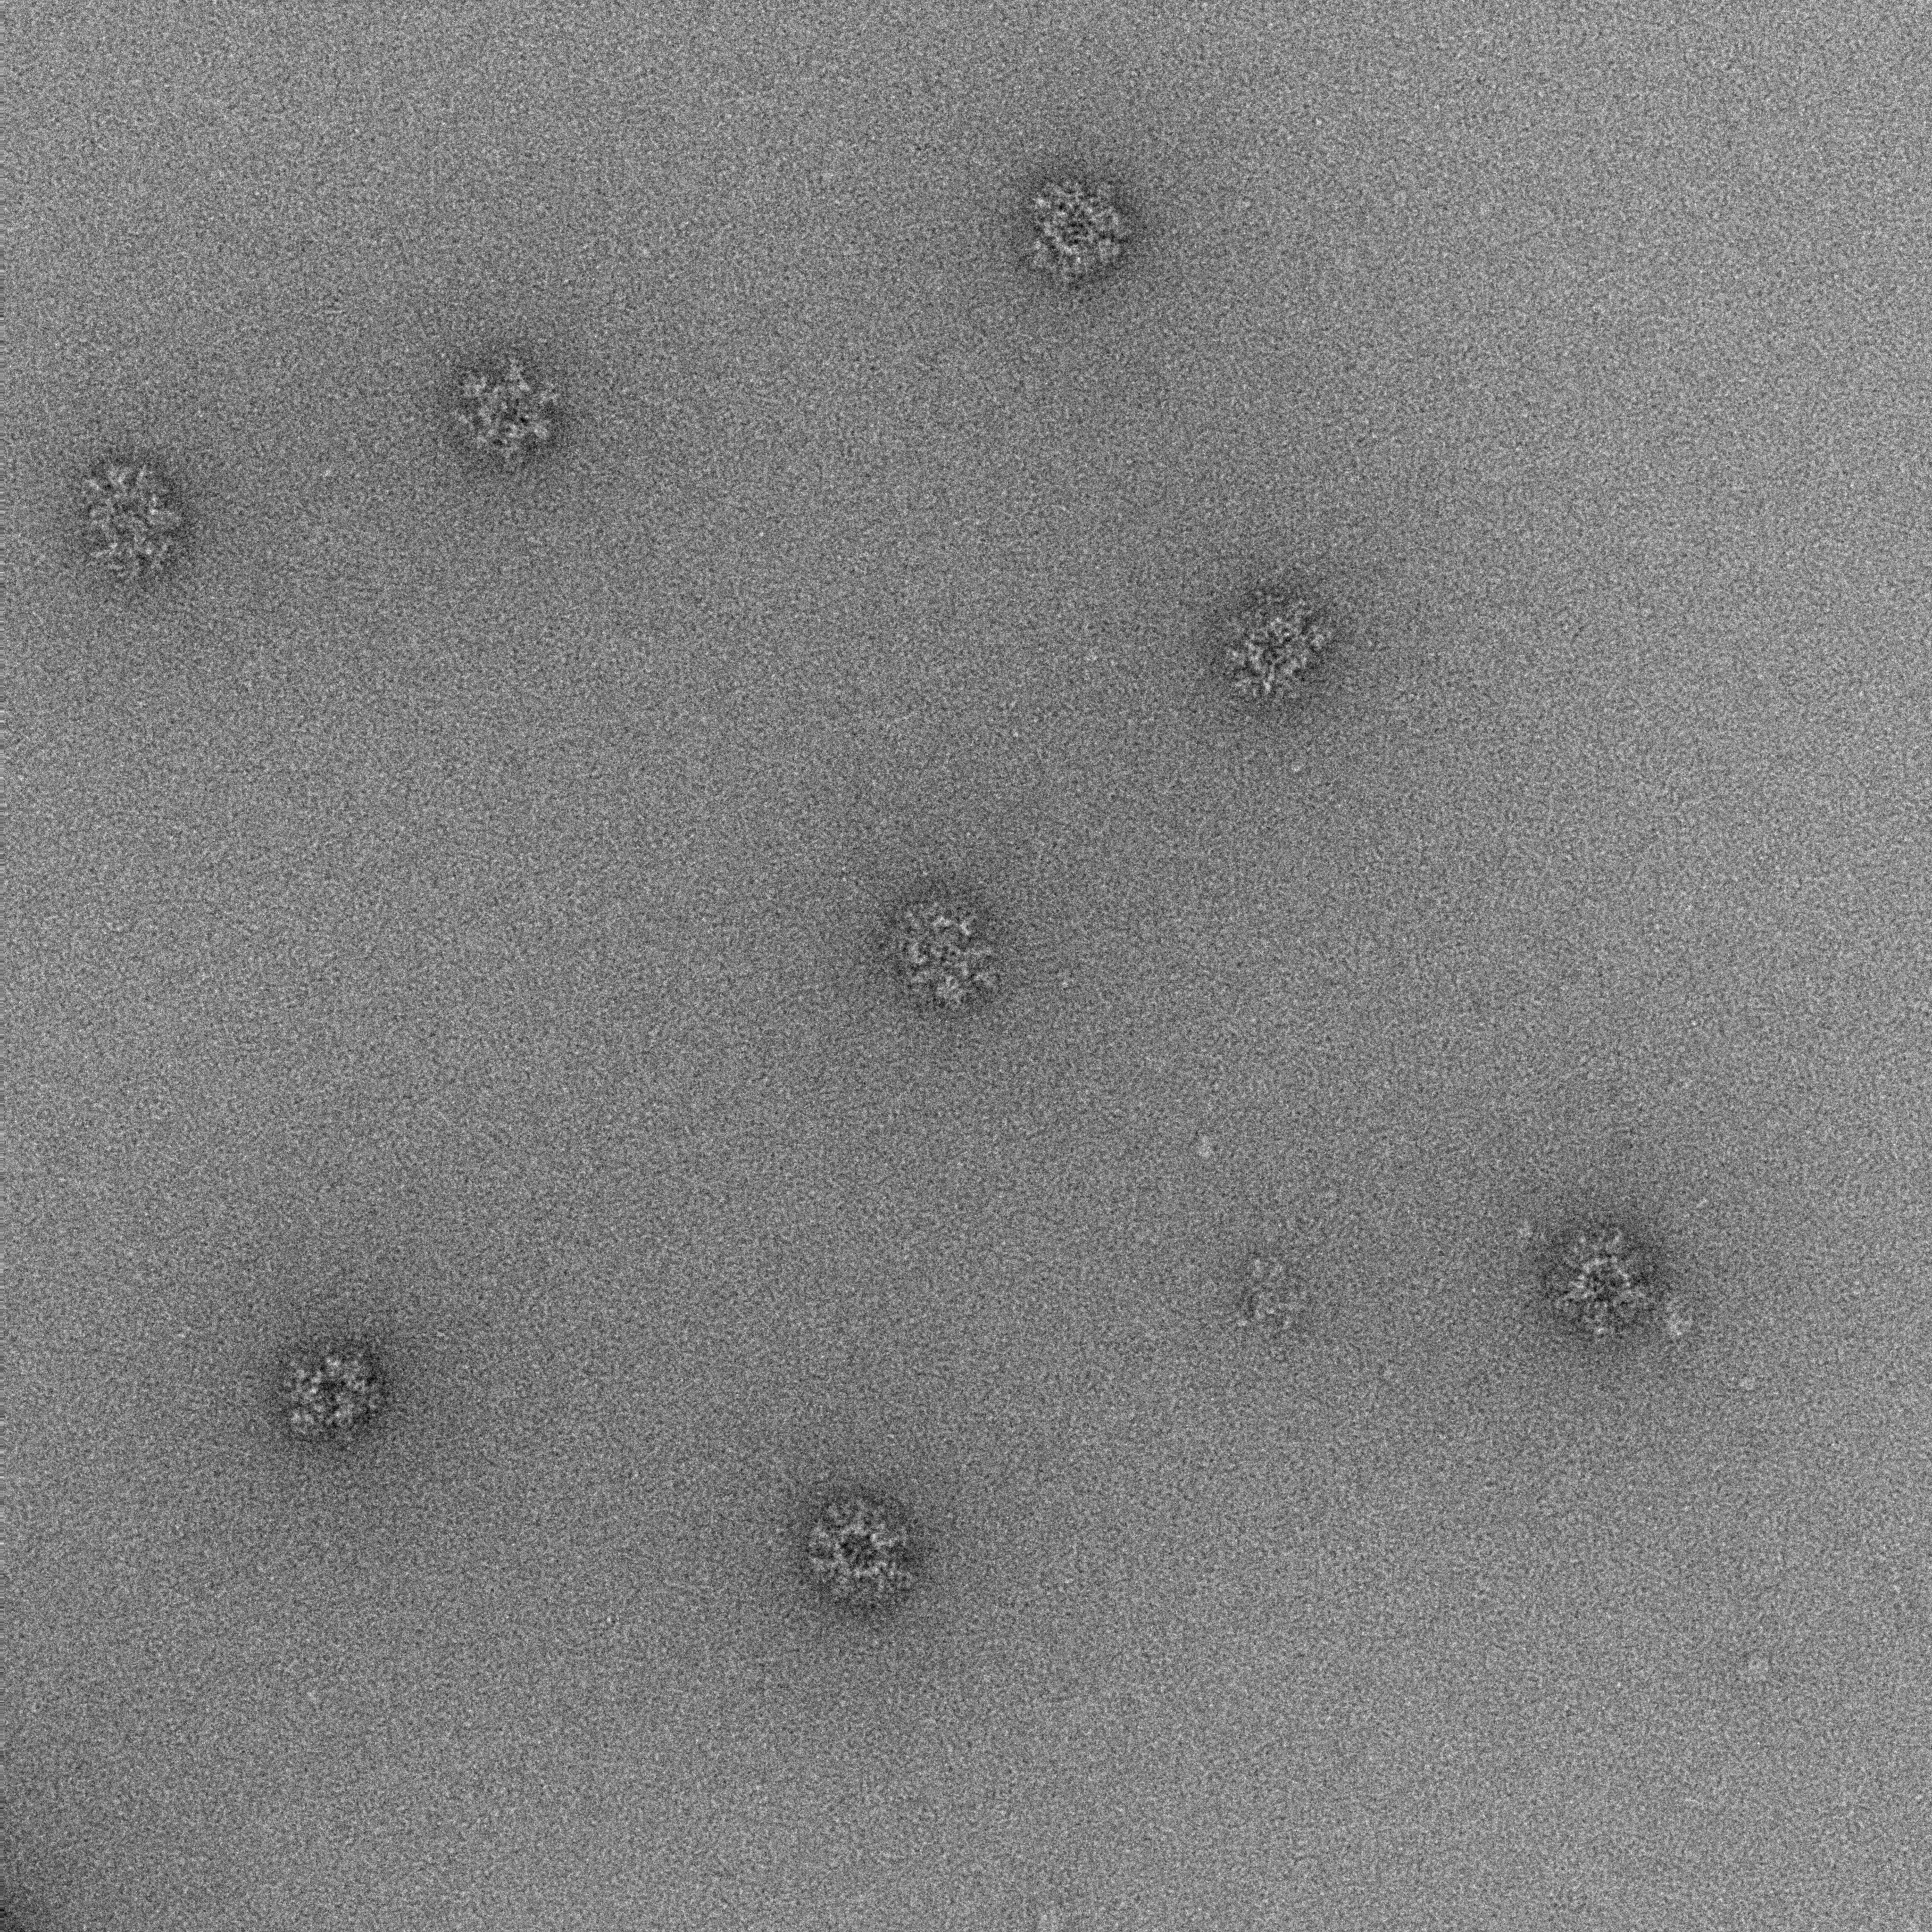
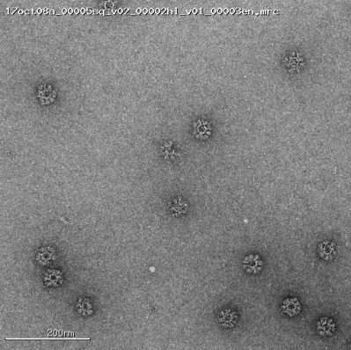
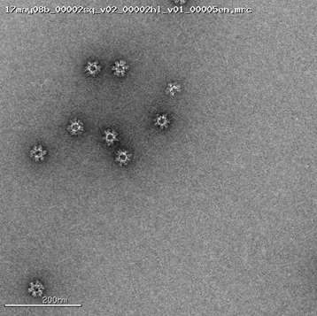
SOSIP trimers from multiple clade can be presented on I53-50 nanoparticles
Clade A
BG505 SOSIP.v5.2
Clade B
AMC011 SOSIP.v5.2
Clade C
ZM197M SOSIP.v5.2*
NP
trimer
NP
trimer
NP
trimer
SEC
DLS
Pd% | Rd (nm)
5.2 | 22.6
Pd% | Rd (nm)
11 | 23.5
Pd% | Rd (nm)
8.2 | 23.3
EM
Philip Brouwer, Chris Cottrell, Aleks Antanasijevic

Slide 37
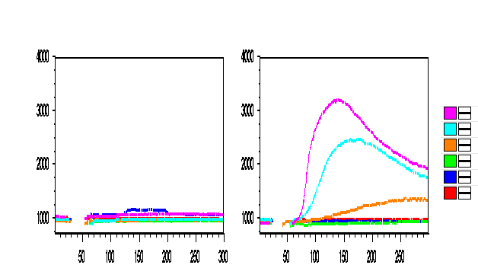
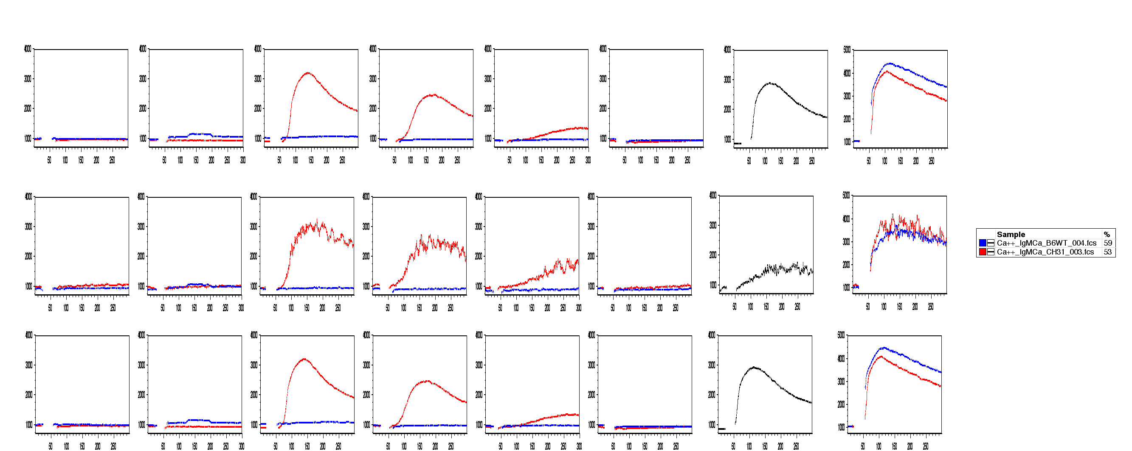
I53-50 nanoparticles enhance activation of VRC01-class germline B cells by BG505 germline-targeting trimers
Wild-type B6 mouse B cells Germline CH31 KI mouse B cells
BG505 SOSIP.v4.1 GT1.2 I53-50NP (100 µg/ml)
BG505 SOSIP.v4.1 GT1.2 I53-50NP (20 µg/ml)
BG505 SOSIP.v4.1 GT1.2 I53-50NP (4 µg/ml)
BG505 SOSIP.v4.1 GT1.2 I53-50NP (0.8 µg/ml)
BG505 SOSIP.v4.1 (100 µg/ml)
BG505 SOSIP.v4.1 GT1.2 (100 µg/ml)
Fluo-4
Time (sec.)
SOSIP.v4.1 SOSIP.v4.1 GT1.2 SOSIP.v4.1 GT1.2 I53-50NP Antigen (BG505 derived)
100 100 100 20 4 0.8 Concentration (µg/ml)
B Cells
Transitional B cells
Mature B cells
Germline CH31 KI mouse B cells
Wild-type B6 mouse B cells
Fluo-4
Laurent Verkoczy
Jinsong Zhang
Barton Haynes
Time (sec.)
Notes:
B cells from CH31 germline KI mice (or control wild-type B6 mice) were incubated with different concentrations of GT1.2 nanoparticles or control reagents.
Calcium flux as an indicator of B cell activation was measured by FACS. Only GT1.2 nanoparticles induced calcium flux in the CH31 germline B cells.
(CH31 is a VRC01-class bNAb).

